Slide 1




Inventory Management Data Analysis using Excel
STUDENT NAME:A.TAMIL SELVAN
REGISTER NO:422200024
DEPARTMENT:BCOM(ISM)
COLLEGE SIVETCOLLEGE

Slide 2
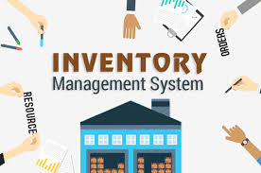

Slide 3


AGENDA
Problem Statement
Project Overview
End Users
Our Solution and Proposition
Dataset Description
Modelling Approach
Results and Discussion
Conclusion
3/21/2024 Annual Review

Slide 4

PROBLEM STATEMENT
it’s a completely manual system that isused for managing inventory processing which leads to time wasting (i.e. stock takingand updating of the stock cards on daily basis).
The Storekeeper also has problem in producing any report on stock count, location details. The daily business makes iteven harder as report has to updated manually.
The collection's details are hard to record and access from a centralized database isnot possible. Some of the collection's information maybe lost or missed out during theoperation. It is hard for storekeeper to maintain and access the collection's record.

Slide 5

PROJECT OVERVIEW
Enhance Data Accuracy: Improve accuracy in inventory records through automated updates and error-reduction mechanisms.
StreamAutomate Inventory Tracking: Implement real-time tracking of inventory levels to minimize stockouts and overstock situations.
line Order Management: Facilitate seamless order processing, from procurement to sales fulfillment.

Slide 6

WHO ARE THE END USERS?
Retailers
2. Manufacturers
3. Wholesalers and distributors
4. Logistics and transportation provider
s5. Healthcare organizations
6. Food and beverage companie
7. E-commerce businesses
8. Warehousing and storage facilitie
9. Pharmaceutical compan

Slide 7

OUR SOLUTION AND ITS VALUE PROPOSITION
Real-Time Inventory Tracking: Monitor stock levels and movements in real time to prevent stockouts and overstock situations.
Automated Replenishment: Smart algorithms that automate restocking based on sales trends and inventory thresholds.
Intuitive Dashboard: A user-friendly interface with customizable dashboards that provide at-a-glance insights into inventory health.
Mobile Access: A mobile application enabling on-the-go inventory management for flexibility and responsiveness.
Robust Reporting Tools: Generate detailed reports and analytics for better demand forecasting and strategic planning.

Slide 8
Dataset Description
Dataset Name: Inventory Management
DatasetDescription: This dataset contains information related to inventory management, including product details, stock levels, storage, supply chain, and transactional data.

Slide 9
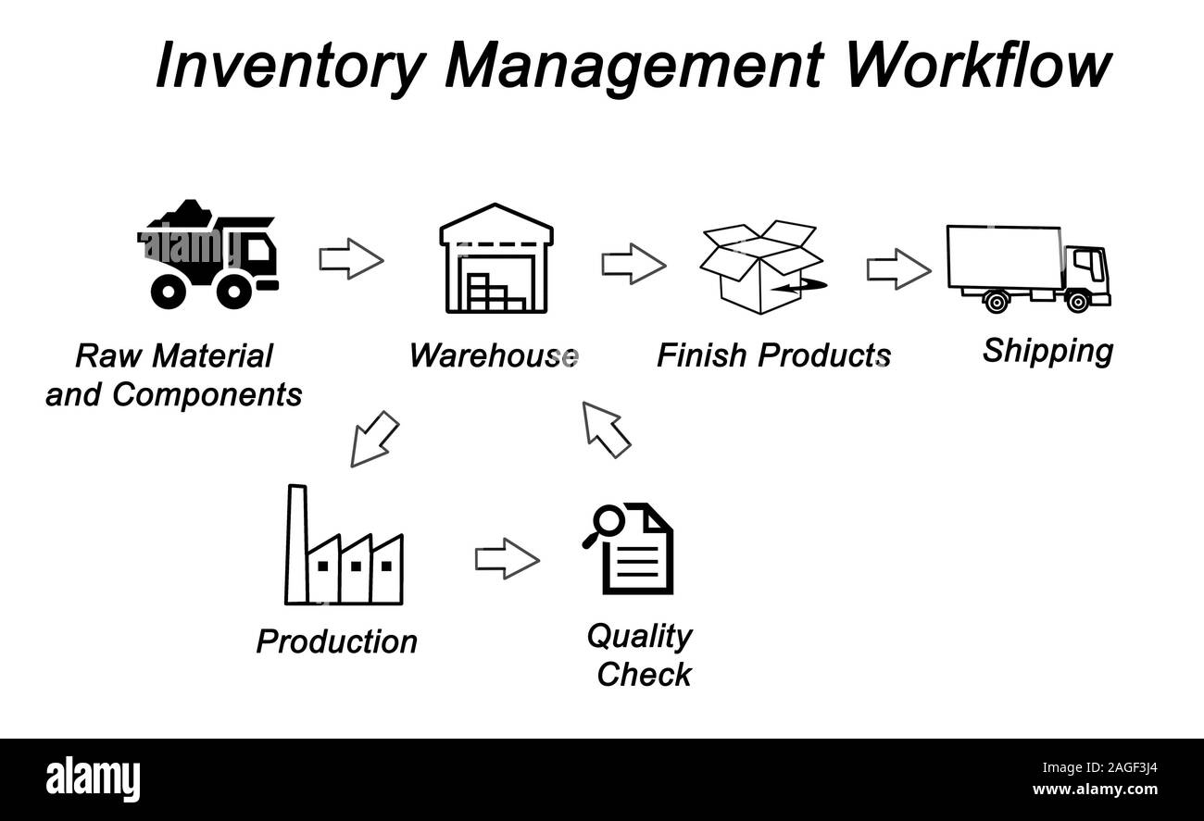


THE "WOW" IN OUR SOLUTION
3/21/2024 Annual Review
9

Slide 10
MODELLING
Inventory Management Models
Economic Order Quantity (EOQ): Calculates the optimal order quantity that minimizes total inventory costs, including holding and ordering costs.
Formula: EOQ=2DSHEOQ = \sqrt{\frac{2DS}{H}}EOQ=H2DS​​
DDD: Demand rate
SSS: Ordering cost per order
HHH: Holding cost per unit per year
Reorder Point (ROP): Determines the stock level at which a new order should be placed to avoid stockouts.
10

Slide 11
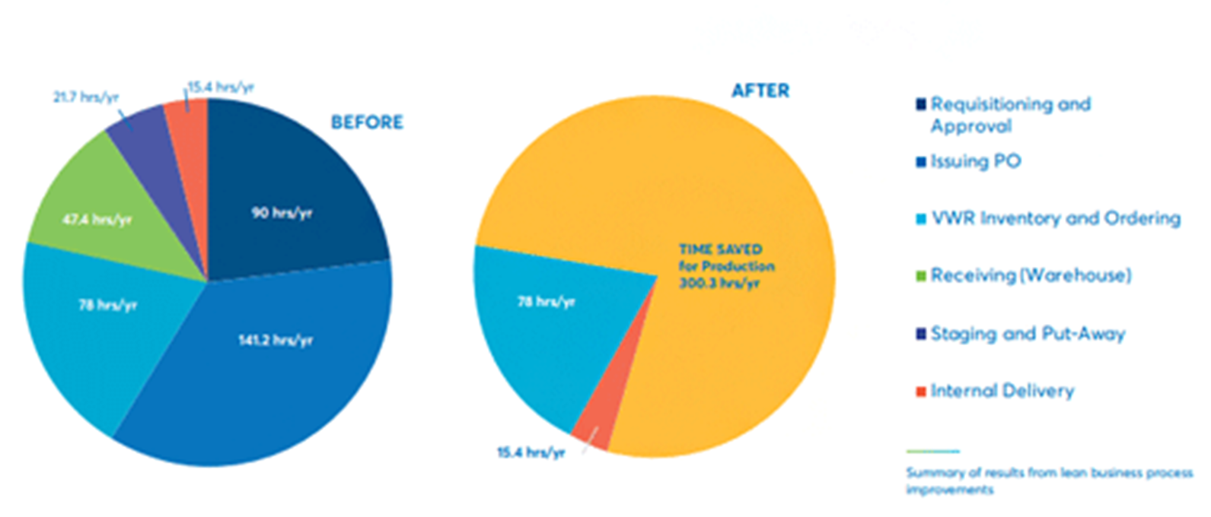
RESULTS
11

Slide 12
conclusion
Inventory management is a critical process for businesses to ensure they have the right amount of inventory at the right time. Here are some conclusions about inventory management:
Importance
An effective inventory management system is vital for a company's success. It can help businesses reduce costs, improve customer satisfaction, and increase profits.
Strategies
Inventory management strategies vary by industry. For example, oil depots can store large amounts of inventory for extended periods of time, while businesses dealing with perishable goods need to avoid sitting on inventory.

